Slide 1
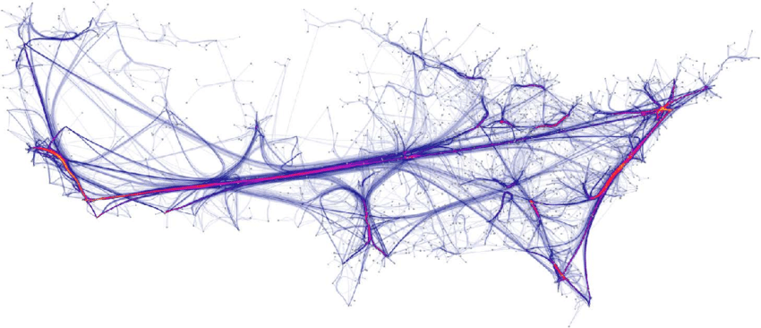
EDGE BUNDLING
Human Computer Interaction and Information Visualization
DECEMBER 2021
Brahmashwini Regonda - 887689

Slide 2
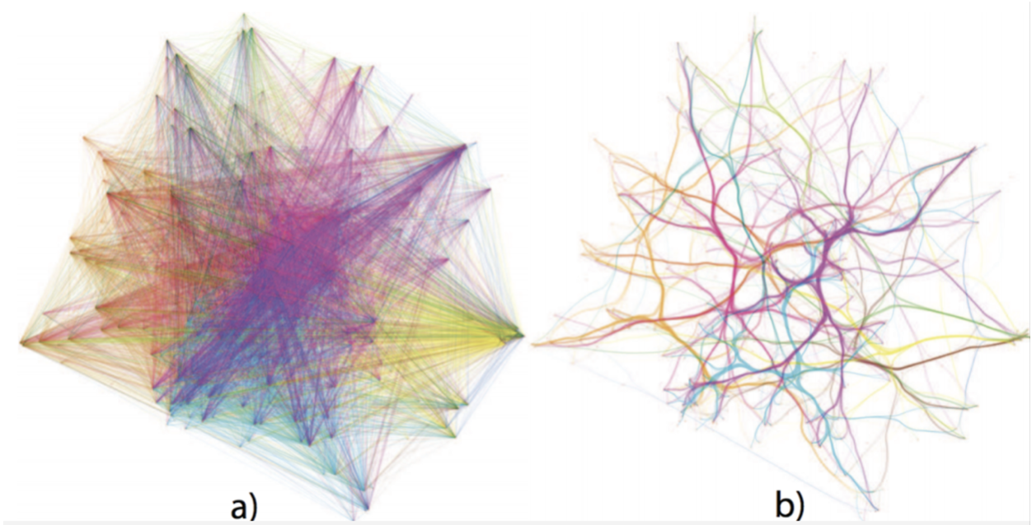
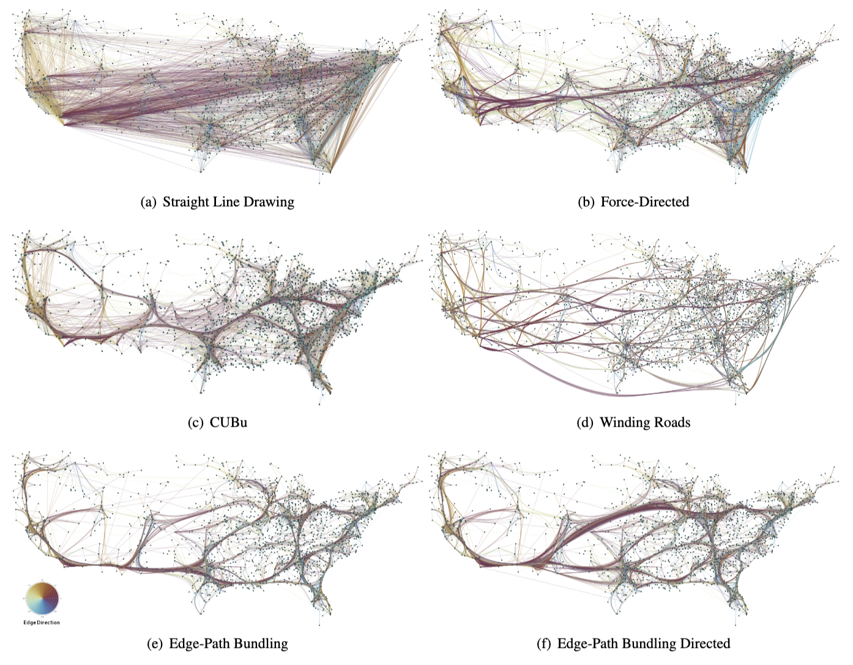
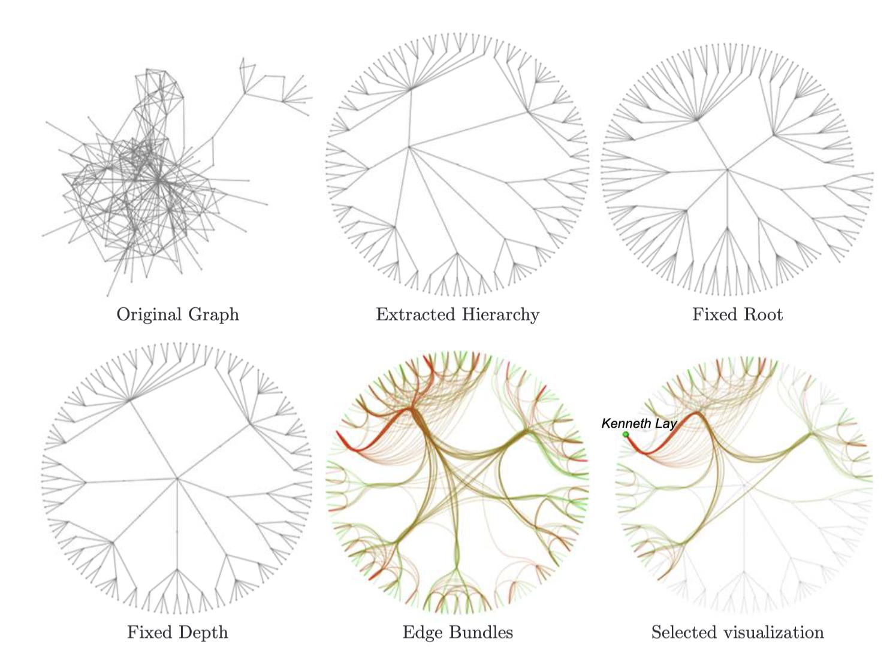
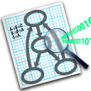
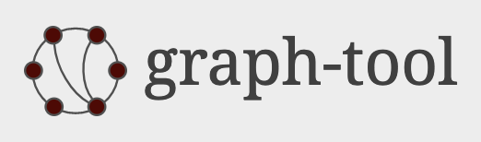



1.
Edge Bundling
2.
Edge Bundling Techniques
Topics
3.
Hierarchical Edge Bundling
4.
Tools
5.
Strength and Weakness

Slide 3
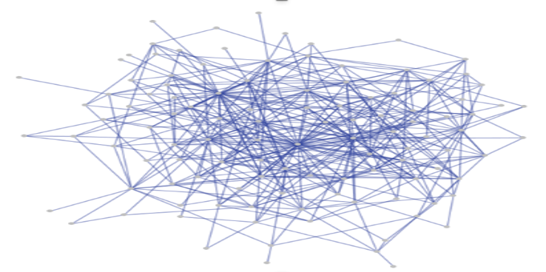
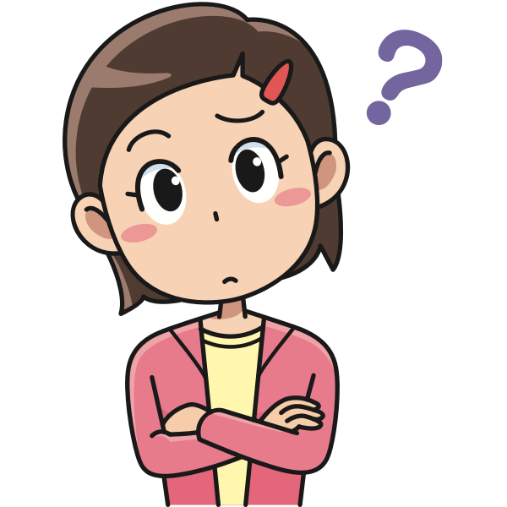
What is the problem in this graph?
A very basic problem with visualizations of dense data with a very high number of relations, edges and this mass of edges can produces immense “Visual Clutter”.
Patterns within the such kind of graph structures can be unclear or completely hidden and important connections can be fail to notice.

Slide 4
1.Edge Bundling

Slide 5
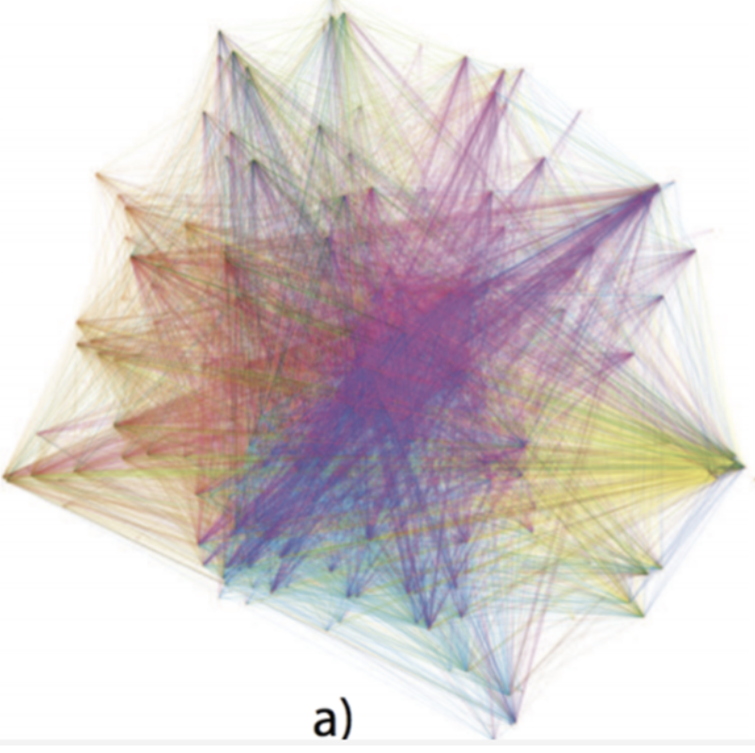
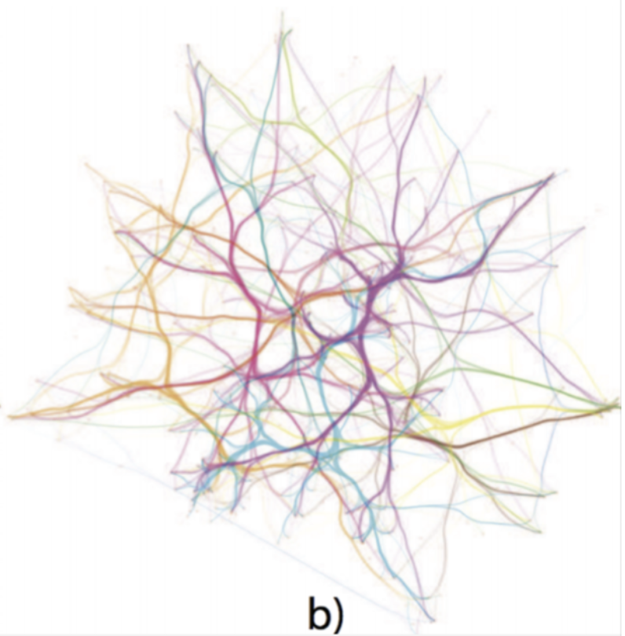
Edge Bundling
EDGE BUNDLING is a technique designed to visually bundle similar edges to reduce the visual Clutter with in a graph.
Visual cluttering can make a graph nearly impossible to analyze[a]
Edge bundling is one technique to cope with this problem[b]

Slide 6
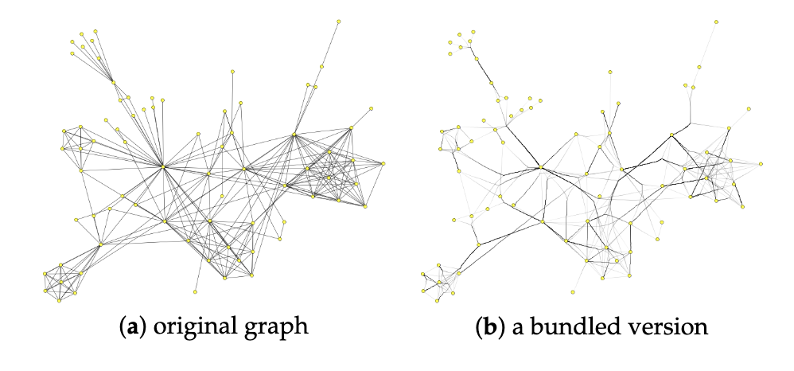
Edge Bundling : Example [paper]
This example has gained attention as a way to improve the readability of a graph drawing by merging geometrically close edges into bundles .

Slide 7
2.Edge Bundling Techniques

Slide 8
Edge Bundling Techniques [Paper]
Unbundled.
Aggregates edges well but over aggregates at the centre of the drawing making it difficult to see patterns.
Drawback at the centre of the map to a lesser degree.
It divides this structure into several smaller flows, but they may not be necessarily related to graph structure(a)
Able to distinguish between several flows that reflect paths in the underlying graph.
When edge direction is considered, the algorithm is able to further subdivide these flows based on direction.

Slide 9
Edge Bundling Techniques[Paper]
Edge bundling techniques cluster edges with similar attributes together to reduce the visual clutter.
All edge bundling techniques cluster groups of individual edges, or parts of them, together based on attributes.
This techniques helps to highlight important edge patterns and often makes it easier to spot important data.
In all the techniques unbundled graph is converted to different Edge Bundling Techniques.

Slide 10
3.HIERARCHICAL Edge Bundling

Slide 11
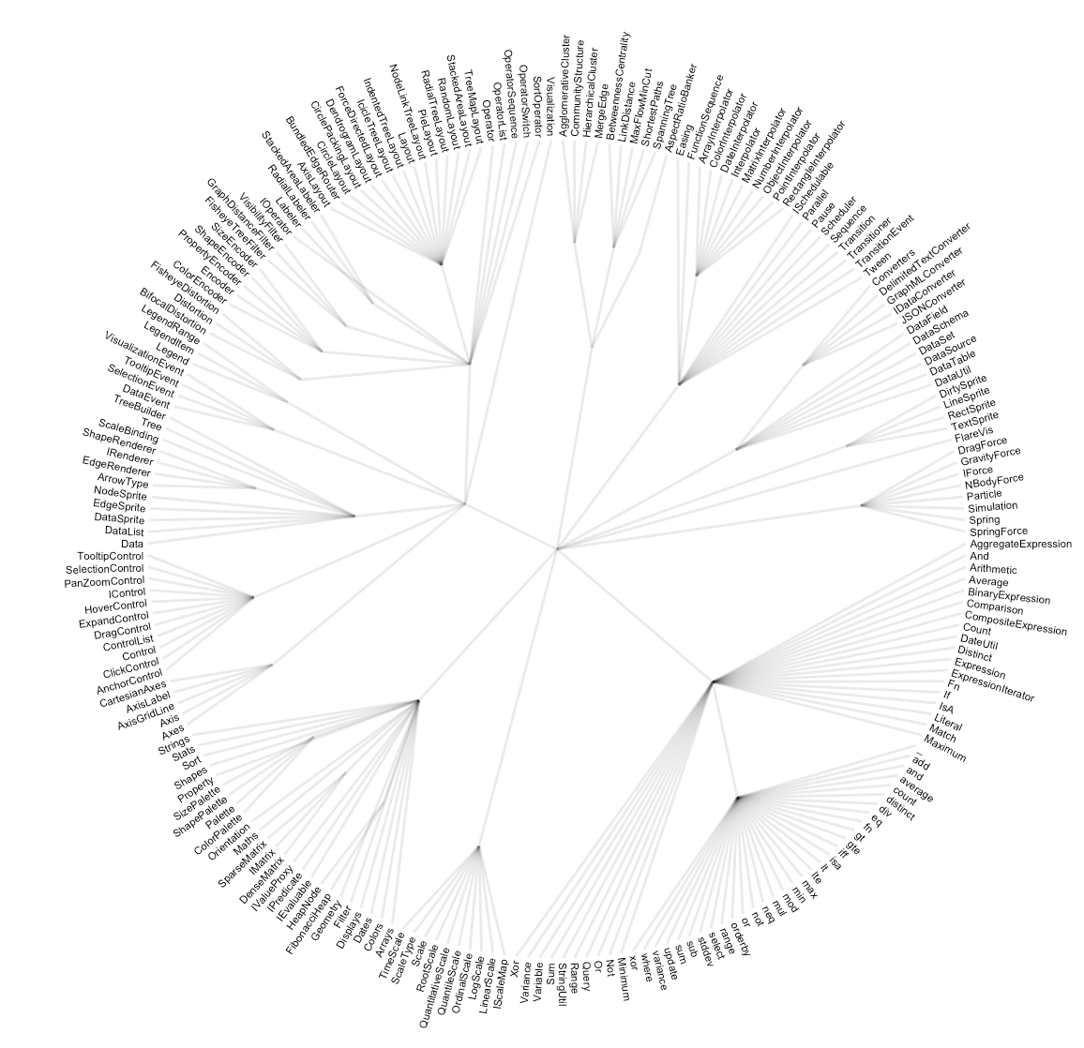
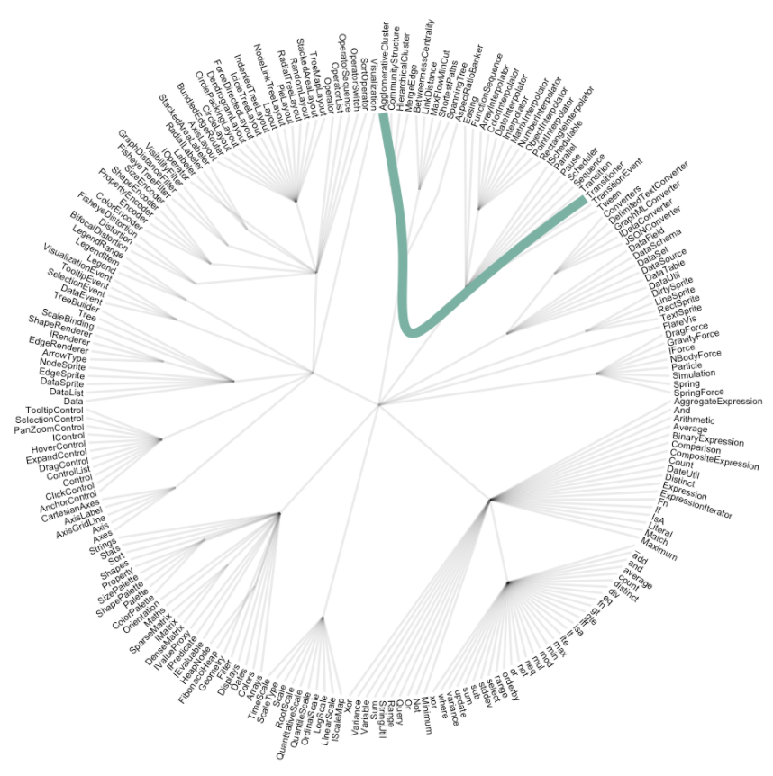
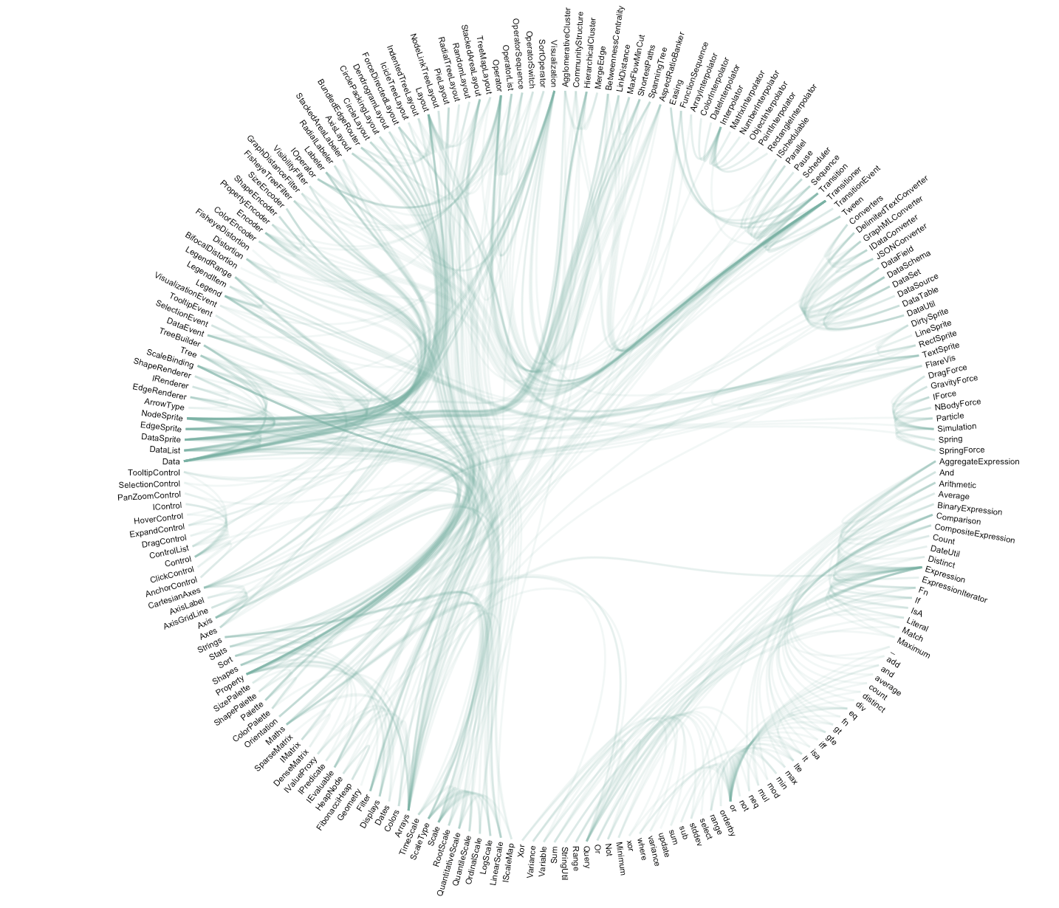
HIERARCHICAL EDGE BUNDLING
It visualize adjacency relations between entities organized in a hierarchy.
The idea is to bundle the adjacency edges together to decrease the clutter.
Hierarchical edge bundling uses a curve that follows the hierarchy link between the 2 elements.
Input
Output(ggpraph R library)
It does not show the hierarchy of the dataset to decrease the clutter as much as possible.
It results in a smooth eye catching figure where connection get obvious and the clutter minimal.

Slide 12
HIERARCHICAL Edge Bundling
[Paper]
“Adjusting the Hierarchy”
First explore different root node choices to recentre the tree layout so that no child of the root node
represents more than half of the original graph nodes.(This is feasible if the root has more than two children)

Slide 13
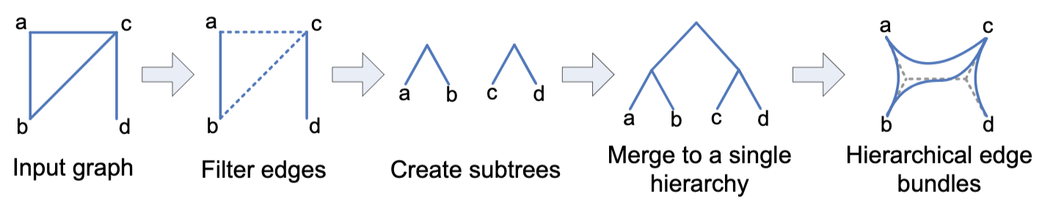
HIERARCHICAL Edge Bundling
[Paper]
A balanced community hierarchy for an input graph in three steps.
Balanced Community Hierarchy Construction
1
2
3
“Work Flow”

Slide 14
4.TOOLS

Slide 15
Tools:Graphviz
It is an open-source graph visualization tool.
Website: http://www.graphviz.org/
Technology: C
Platforms: Windows, Mac, Linux
Input (Executables Reads
the graph structure using
DOT graph description lang)
Filter(Mingle for EB)
Output(ex:PNG images)
Transformations on Dot based graphs required filters.

Slide 16
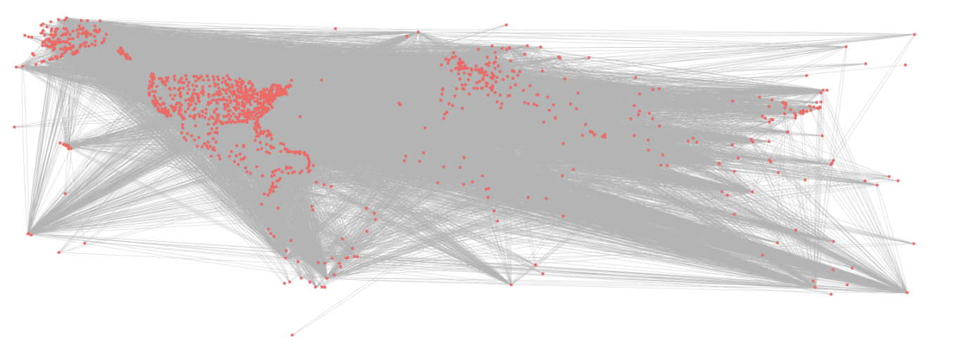
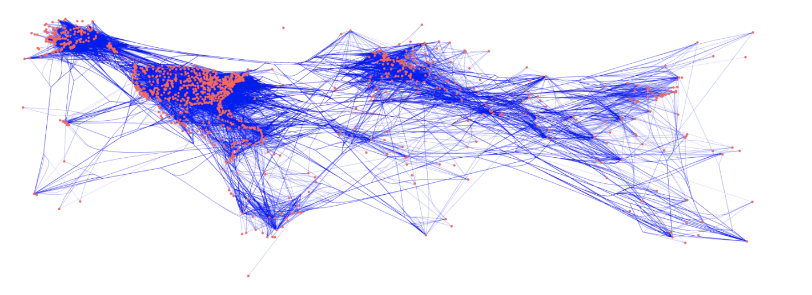
Tools:Graphviz
Graphviz result without edge bundling.
Graphviz edge bundling
result from the mingle filter.

Slide 17
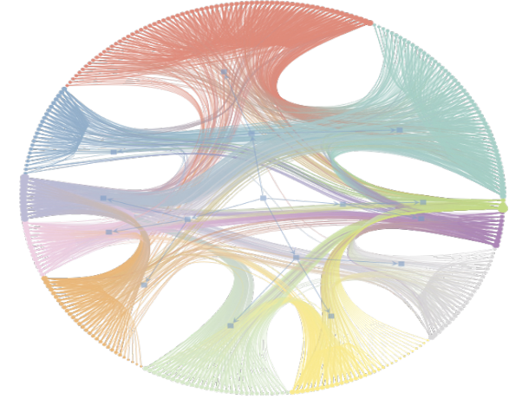
Tools: Graph-tool
Website: https://graph-tool.skewed.de/
Technology: Python, C++
Platforms: Mac, Linux, Windows
Hierarchical edge bundling example created using graph-tool.

Slide 18
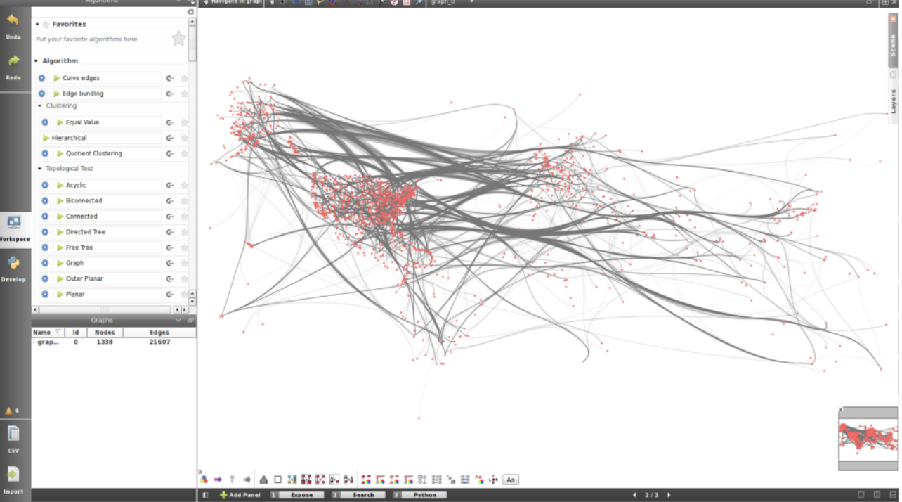
Tools: Tulip
Website :http://tulip.labri.fr
Technology :C++
Platforms: Windows, Mac, Linux
open-source graph visualization and analysis tool
Tulip edge bundling with Bezier curves

Slide 19
Tools: Other Tools
We have seen three tools and below are the tools which helps us to do Edge Bundling:
Gephi
MATLAB
D3 - Force Edge Bundling
MingleJS
R
There are several different techniques, each with their advantages and different fields of applications.

Slide 20
5.Strength and Weakness

Slide 21
Weakness
Edge bundling can make it considerably harder depending on the technique to follow edges from their start towards their destination. This happens because depending on the edge bundling technique used multiple edges might be partially merge which makes it impossible to distinguish them.
If changes the position of the nodes in the graph, which can be a problem for specific graphs like for instance geographical information is encoded in the position of the nodes.
In few techniques the resulting ambiguous connections some times do not exist in the actual graph.
Strengths
Edge-bundling methods may have certain advantages when utilized with useful interaction tools.(Ex:Tulip)
Edge bundling has emerged as a promising and important technique for reducing visual clutter in visualizations.
Bundling can help to highlight important edge patterns and often makes it easier to spot interesting connections or important data

Slide 22
References:
1.https://www.data-to-viz.com/graph/edge_bundling.html
2.https://github.com/cytoscape/cytoscape.js/issues/2332
3.https://courses.isds.tugraz.at/ivis/surveys/ss2017/ivis-ss2017-g4-survey-edge-bundling.pdf
4.https://lliquid.github.io/homepage/files/ts13_edgebundle.pdf
5.https://www.researchgate.net/publication/353862978_Edge-Path_Bundling_A_Less_Ambiguous_Edge_Bundling_Approach
6.https://www.researchgate.net/publication/32965425_Hierarchial_Edge_Bundles_for_General_Graphs
7.https://www.researchgate.net/publication/326006414_An_Evolutionary_Algorithm_for_an_Optimization_Model_of_Edge_Bundling

Slide 23
Thank you !!!

